Slide 1



Report
Summer Project
Alireza Motazedian
Advisor:
Prof. MD Shaad Mahmud

Slide 2

Weekly Report 1
05/25/2023

Slide 3

Tasks
1
System Set-up and Files management
Literature Review and Idea Generation
Discussion with Talha
Data Acquisition
Need for Additional Suggestions

Slide 4

System Set-up and Files Management
2
Notes:
I dedicated some time this week to setting up my system. I installed Windows and all the necessary software to ensure everything is up and running smoothly. Additionally, I installed Linux on my laptop, which will definitely come in handy for our work. Furthermore, I organized all the files and materials that are important for our project. Now everything is neatly arranged, making it easier for me to access the required information.

Slide 5
Weekly Report 2
06/01/2023

Slide 6



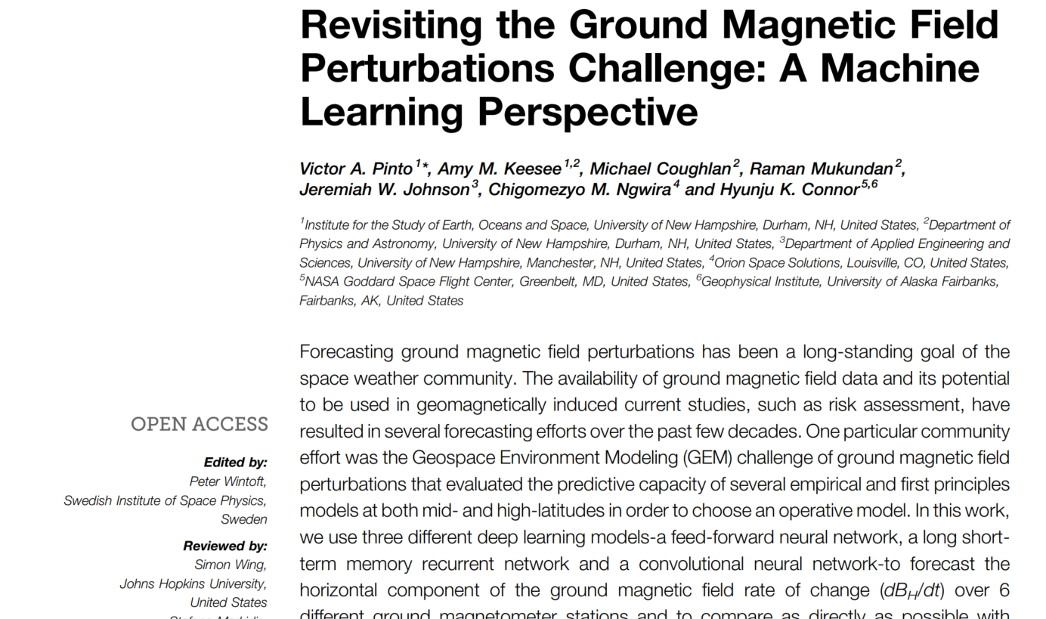
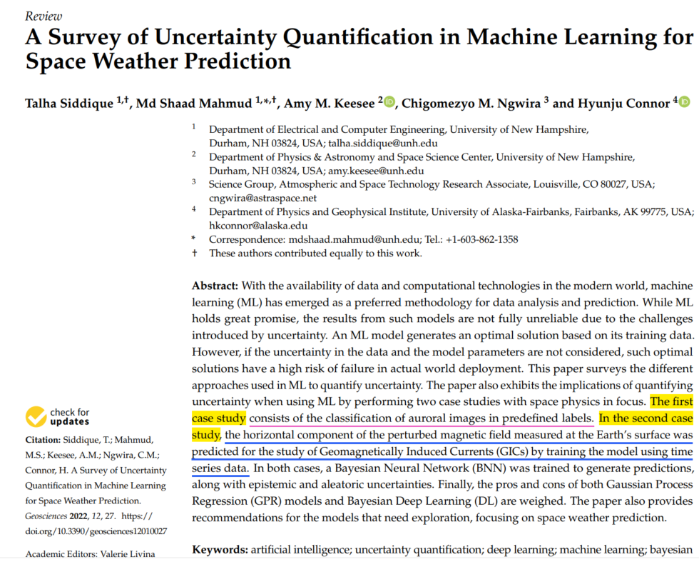
Literature Review
1

Slide 7
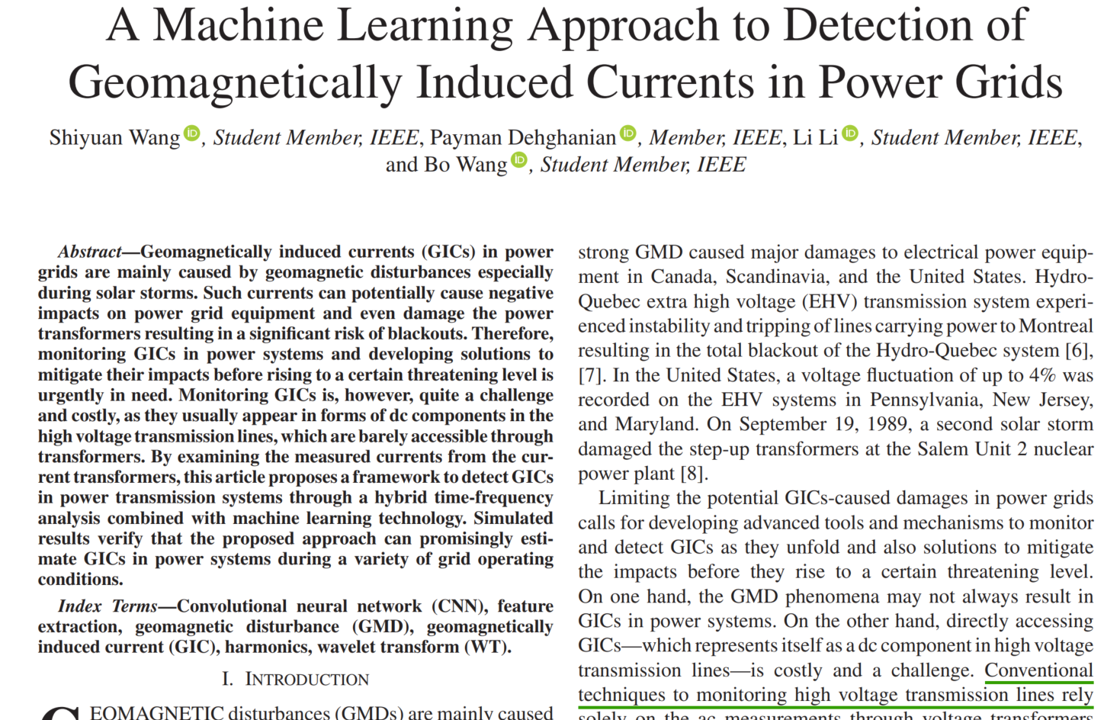
Thermal effects on superMAG data
2

Slide 8
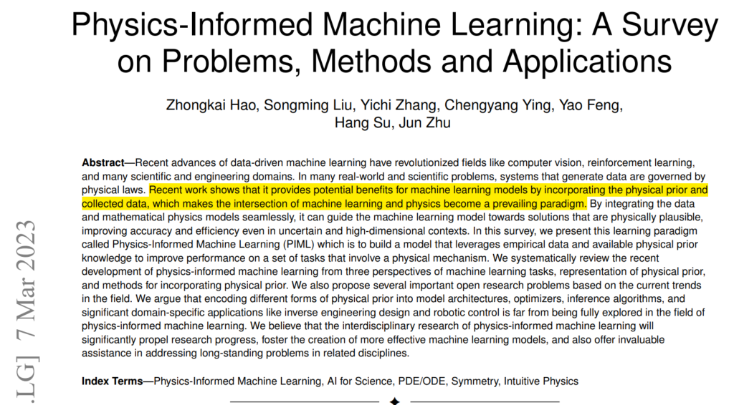
Physics-Informed Machine Learning
3

Slide 9
Weekly Report 3
06/07/2023

Slide 10
Physics-Informed Machine Learning
1
Introduction:
Problem Formulation:
Possible Ways towards PIML:
Applications of PIML:
Conclusion:
What we can learn from this paper about predicting GIC:

Slide 11
PIML: Introduction
2
Traditional machine learning algorithms have limitations in incorporating prior knowledge or constraints about physical systems.
Physics-informed machine learning (PIML) is a new approach that seeks to integrate empirical data and physical prior knowledge into machine learning models.
The paper presents a survey of recent developments in PIML and discusses its potential applications.

Slide 12
PIML: Problem Formulation
3
PIML addresses fundamental problems in physics-informed machine learning.
Representation methodology for physical knowledge, approach for integrating physical knowledge into machine learning models, and practical problems that PIML resolves are discussed.
The paper proposes a theoretical framework for machine learning problems with physical constraints based on probabilistic graphical models using latent variables to represent the real state of a system that satisfies physical prior constraints.
The paper also discusses the challenges associated with incorporating physical prior knowledge into machine learning models such as the need for domain expertise, availability of data, and computational complexity.

Slide 13
PIML: Possible Ways towards PIML
4
The incorporation of physical prior knowledge can be achieved through modifications to one or more components of the machine learning model.
Training data, model architecture, loss functions, optimization algorithms, and inference can all be modified to incorporate physical prior knowledge.
The paper discusses several approaches for incorporating physical prior knowledge into machine learning models such as hybrid modeling, probabilistic graphical models, and feature engineering.
The paper also provides examples of how different types of physical prior knowledge can be incorporated into machine learning models such as conservation laws, symmetries, and constitutive relations.

Slide 14
PIML: Applications of PIML
5
PIML has been successfully applied in various fields such as fluid dynamics, materials science, and robotics.
By incorporating physical prior knowledge into machine learning models, improved performance and better alignment with practical problems that adhere to the laws of physics can be achieved.
The paper provides examples of successful applications of PIML such as predicting fluid flow behavior in complex geometries, designing new materials with desired properties, and controlling robotic systems.

Slide 15
PIML: Conclusion
6
PIML is a promising new paradigm for solving physical problems using machine learning.
By integrating empirical data and physical prior knowledge into machine learning models, it is possible to overcome the limitations of traditional machine learning algorithms and achieve improved accuracy and efficiency.
The paper concludes by discussing future directions for research in PIML such as developing more efficient algorithms for incorporating physical prior knowledge, exploring new types of physical prior knowledge

Slide 16
PIML: What we can learn from this paper about predicting GIC
7
The paper does not specifically address GIC prediction.
The paper provides a theoretical framework for incorporating physical prior knowledge into machine learning models. This approach can be useful in predicting GIC by leveraging empirical data and available physical prior knowledge to improve performance on tasks that involve a physical mechanism.
For example, the paper mentions that PIML has been applied in several topics of geography, including seismology, which involves the study of earthquakes and their effects on the Earth's magnetic field. Similarly, GIC is caused by variations in the Earth's magnetic field due to solar storms and other space weather events. By incorporating physical prior knowledge about the Earth's magnetic field and its interactions with solar wind and other factors, PIML can help improve predictions of GIC. This could involve modifying components of machine learning models such as training data, model architecture, loss functions, optimization algorithms, and inference to incorporate physical prior knowledge.

Slide 17
Replicate the Amy Keesee’s work
8
My experience during my master's program
Replicating a couple of your works as part of my summer project.

Slide 18
Weekly Report 4
06/15/2023

Slide 19
Canceled
1

Slide 20
Weekly Report 5
06/22/2023

Slide 21
Canceled
1

Slide 22
Weekly Report 6
06/29/2023

Slide 23
Canceled
1

Slide 24
Weekly Report 7
07/06/2023

Slide 25
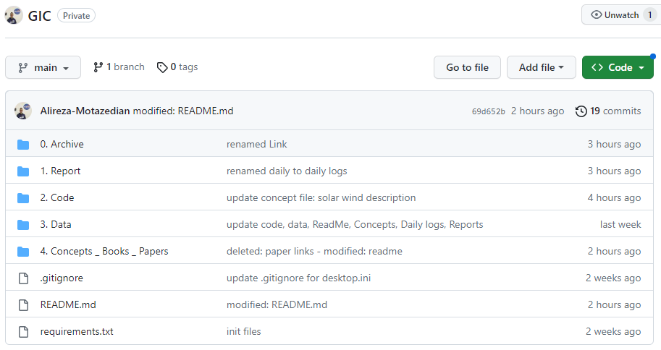
GitHub
1

Slide 26
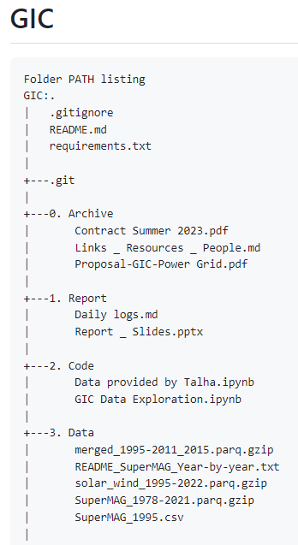
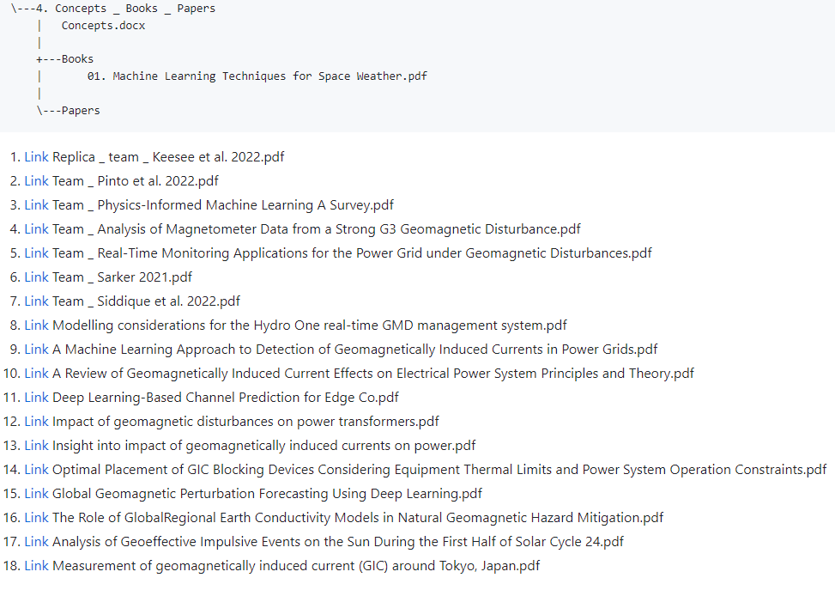
README.md | Folder PATH listing
2

Slide 27
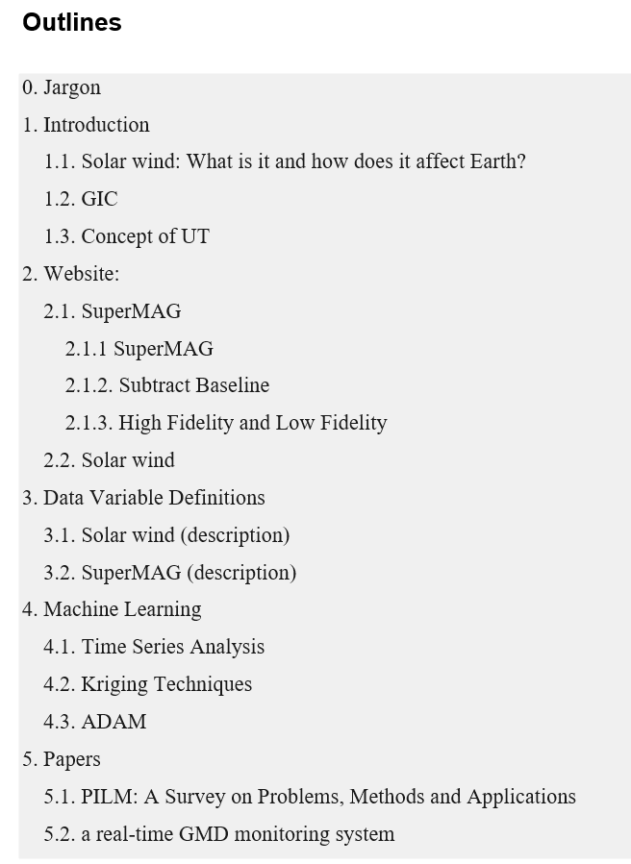
4. Concepts _ Books _ Papers | Concepts.docs
3

Slide 28
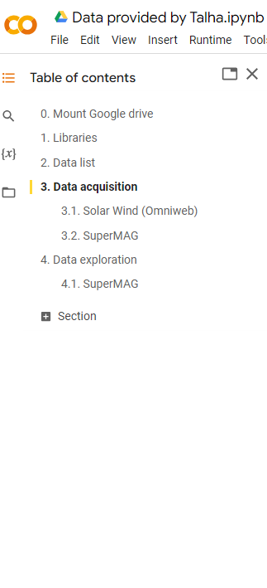
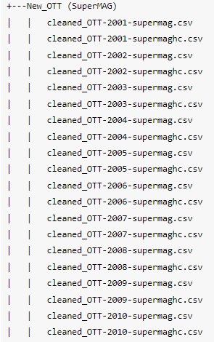
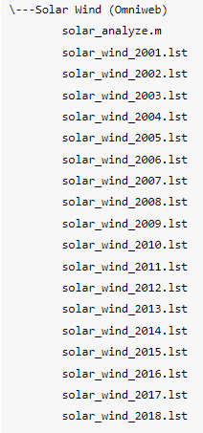
2. Code | Data provided by Talha
4

Slide 29
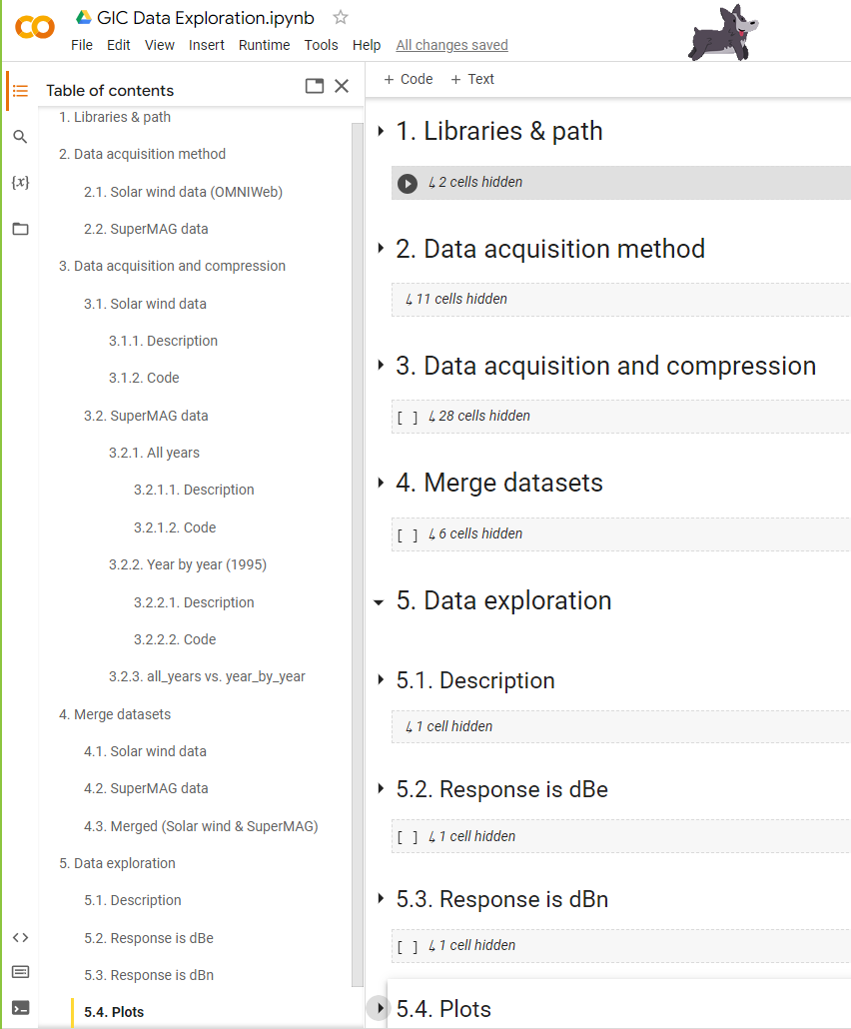
2. Code | GIC data exploration
5
Next slide

Slide 30
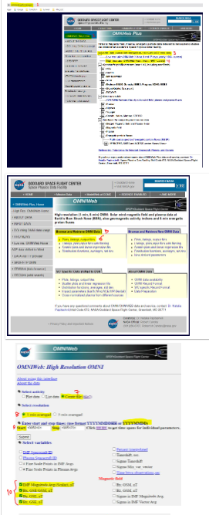
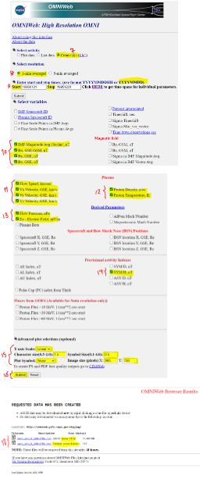

2. Code | Data acquisition method (Thanks Talha)
6

Slide 31
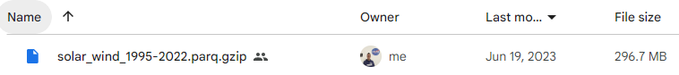
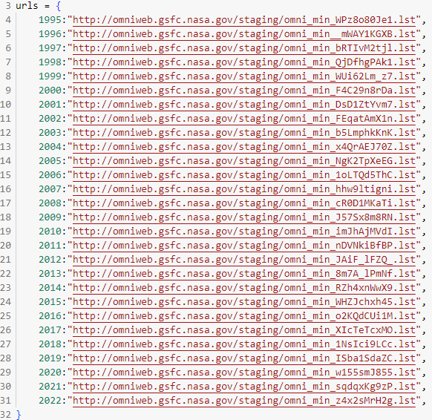
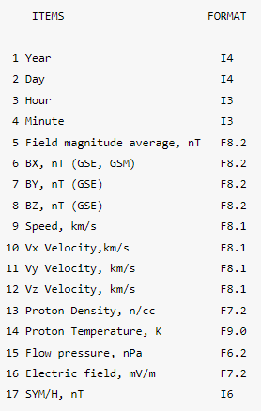
3. Data | Solar wind data
7

Slide 32
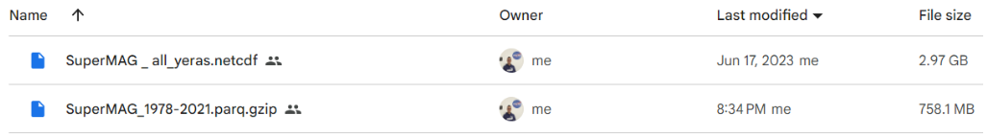
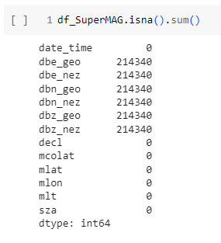
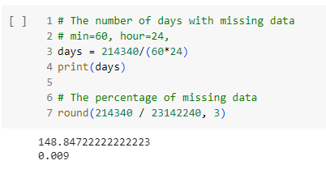
3. Data | SuperMAG
8
Dealing with missing values:
As the data is time-series data, it would be better not to drop missing values. Instead, we can fill NAs with median or miss forest.

Slide 33
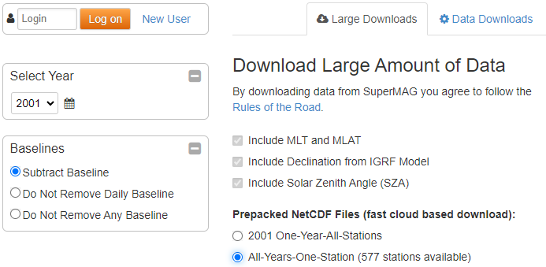
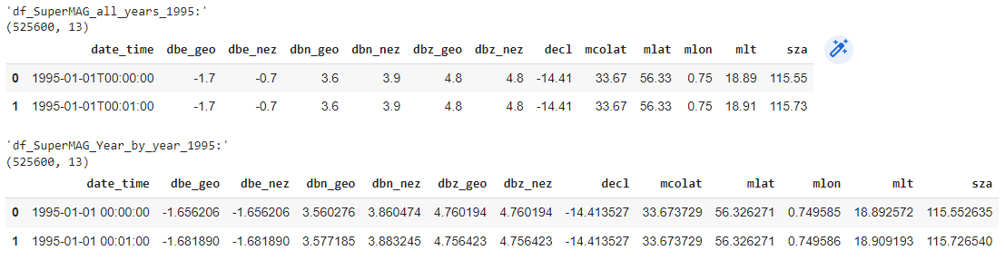
Conflict | all years vs. year by year
9
Large downloads: all years
Data downloads: year by year

Slide 34
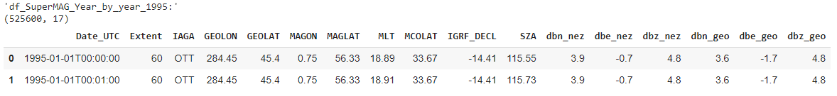
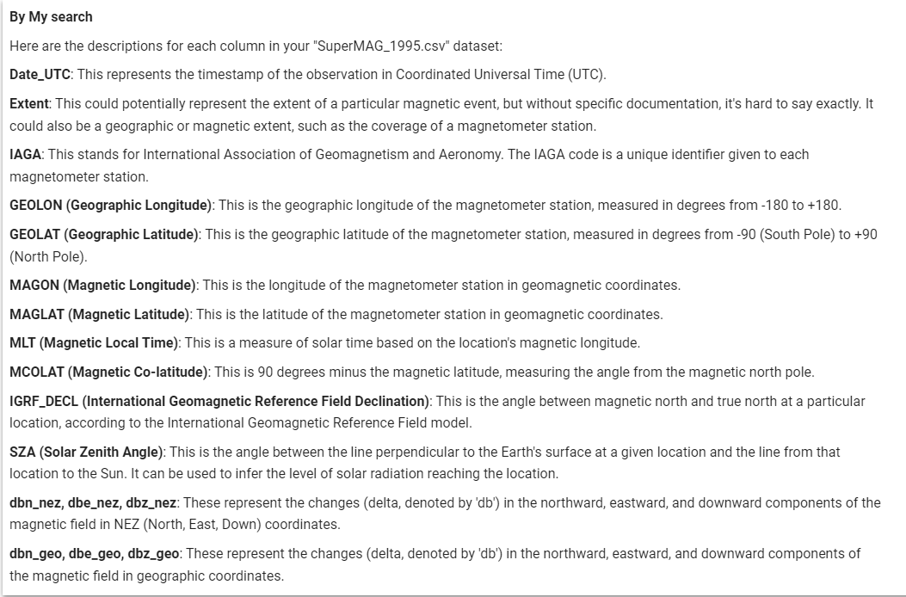
Data issue example
10

Slide 35

High Fidelity vs. Low Fidelity | Question?
11
Thanks, Talha.
Answer:
Low Fidelity
Reason: 1-min

Slide 36
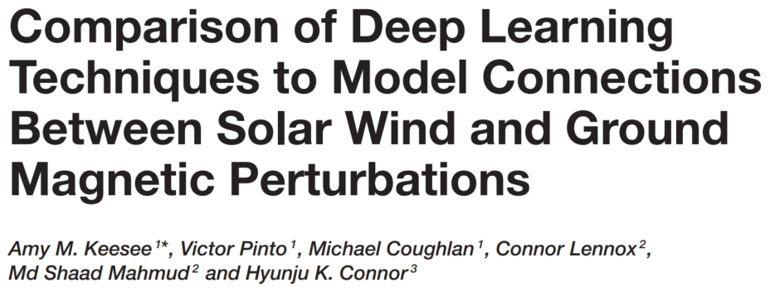
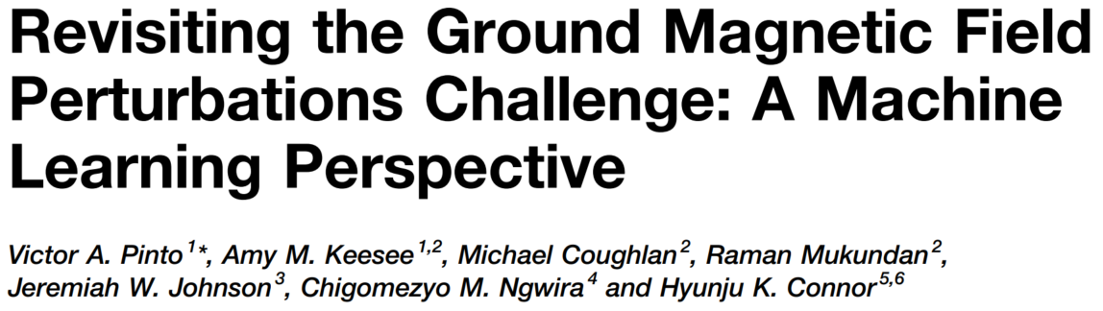
Suggestions
12
Improve the model including adjustments of input parameters.
Increased time history cadence
Comparison to additional time series techniques
More ground station
Hyper-parameter tuning process
Real-time forecasting

Slide 37
My Suggestions
13
Hyper-parameter tuning process
ARIMA
Other DL models

Slide 38
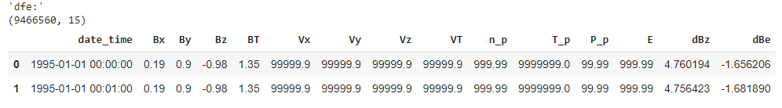
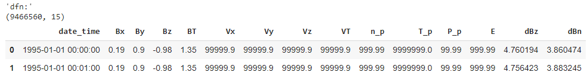
Final data | Responses?
14

Slide 39
Weekly Report 8
07/13/2023

Slide 40
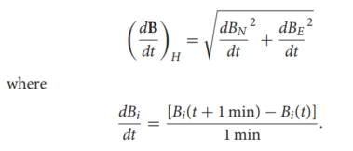
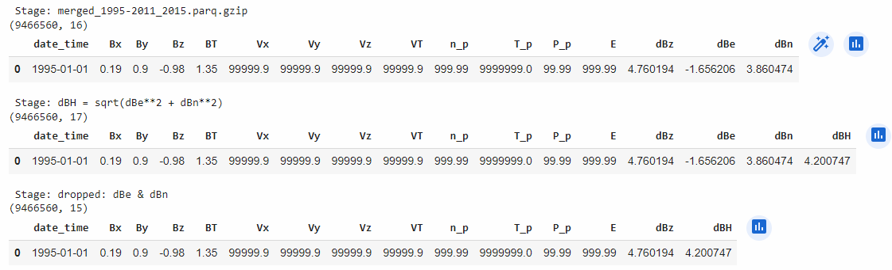
Final data | 2 Responses
1
multi-class classifications
multi-label classifications

Slide 41
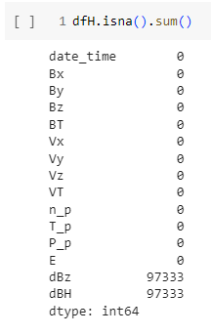
Dealing with missing values
2
Dealing with missing values:
Drop
Fill
Mean
Median
Mode
Constant number or string, like 0 or ‘unknown’
Mice Forest
Miss Forest
KNN Imputation

Slide 42
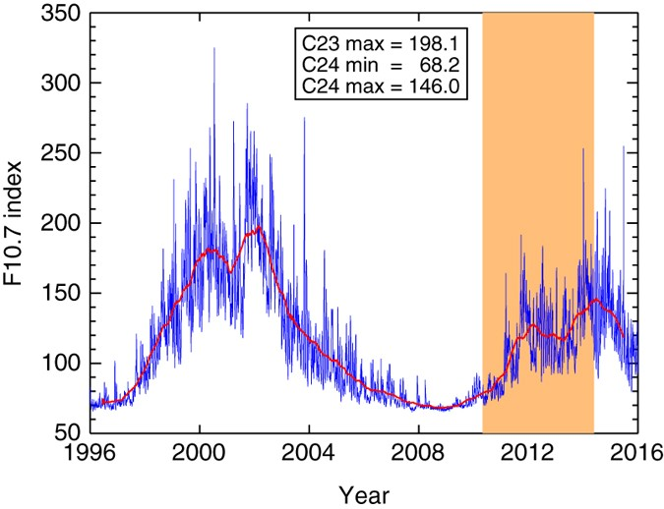
Dropping missing values: rejected
3
1. Dropping missing values
Single data
A set of consecutive data
Not efficient in our work

Slide 43
Filling missing values
4
Fill
Mean
Median
Mode
Constant number or string, like 0 or ‘unknown’
Miss Forest
Mice Forest
KNN Imputation

Slide 44
Miss Forest
5
Miss Forest
well-suited for datasets where the missing values occur in a pattern rather than randomly.
based on the Random Forest model
The basic idea of the Miss Forest algorithm is to treat each feature with missing values as the dependent variable and the other features as the independent variables. A Random Forest model is trained for each feature with missing values using the other features. The missing values are then predicted based on these trained models.

Slide 45
Miss Forest
6
It's important to remember that:
imputing missing values always comes with some uncertainty.
It's generally a good idea to explore your data thoroughly and understand the reasons behind missing values before deciding on an imputation strategy.
Also, while Miss Forest is a powerful imputation method, it may not be suitable for all kinds of data or missing patterns, and it may be computationally expensive for large datasets.

Slide 46
Mice Forest
7
MICE:
MIs (Multiple Imputations) create several possible fills for each missing value
The distribution: a good approximation
Flexible (can handle different data types)
RF (Random Forest)
Powerful
MICE = MIs + RF
MICE combines the flexibility of MICE with the power of random forests. This approach can handle different data types (like categorical and numerical values) and missing data patterns.
MICE (Multivariate Imputation by Chained Equations )
is an imputation method that works by filling the missing data multiple times.

Slide 47
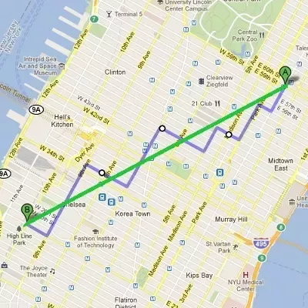
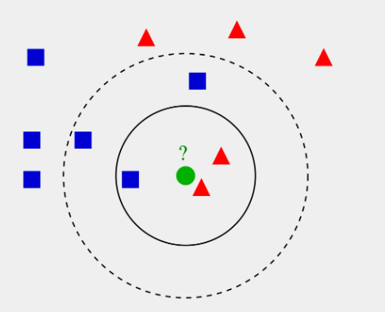
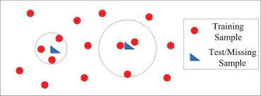
KNN Imputation
8
KNN (K-Nearest Neighbors)
The optimal K may depend on the specific dataset and problem.
Can be time-consuming on larger datasets as each missing value needs to compute distances to all other points.
Assumption: KNN assumes that the dataset has a metric space structure, which may not be the case for all datasets.
Euclidean (metric) distance
vs
Manhattan (taxi-cab) distance
KNN
Classification Regression
Majority vote Mean

Slide 48
Weekly Report 9
07/20/2023

Slide 49
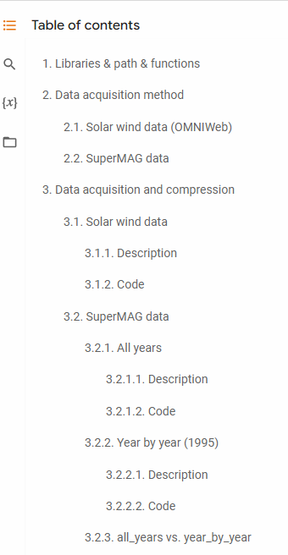
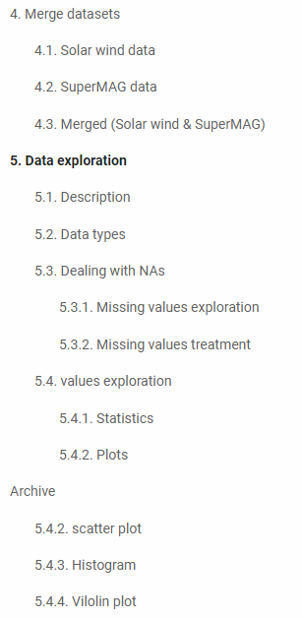
Data preprocessing workflow
1

Slide 50
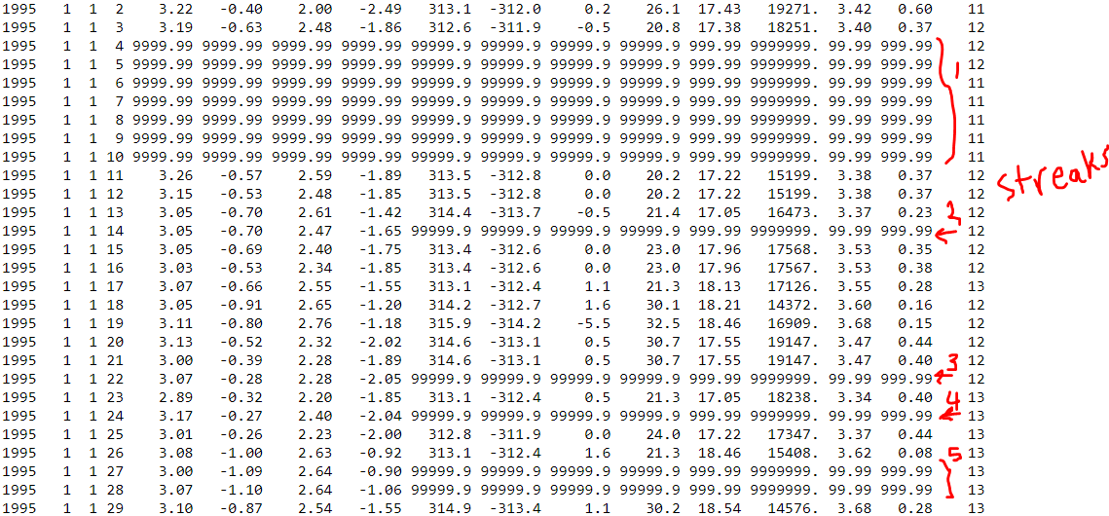
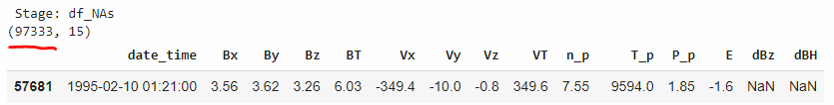
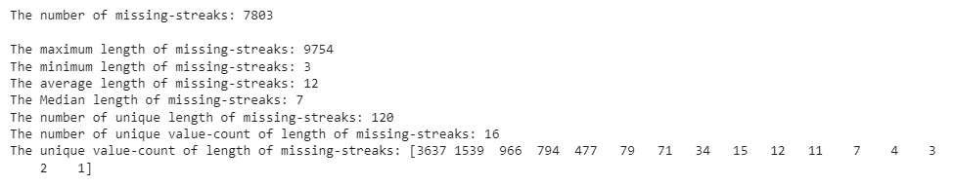
NAs exploration
2

Slide 51
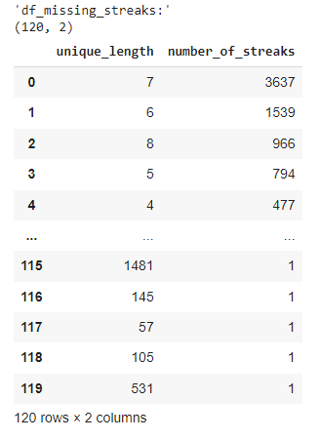
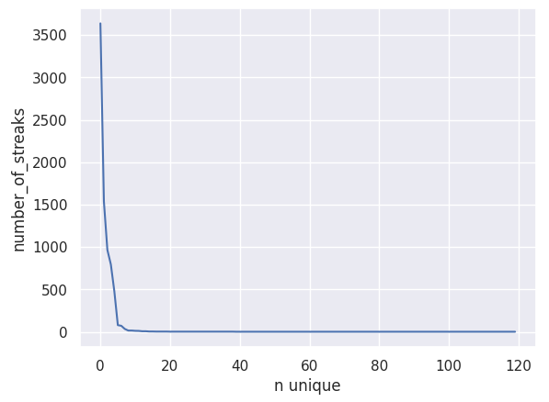
Missing streaks exploration
3

Slide 52
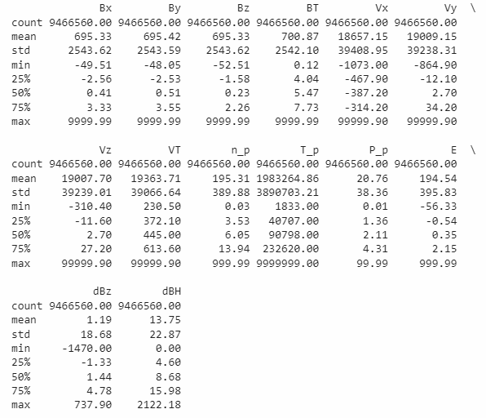
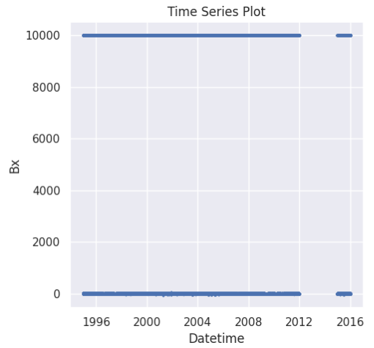
Values exploration | Statistics
4

Slide 53
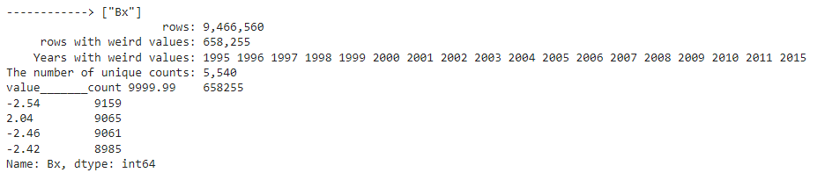
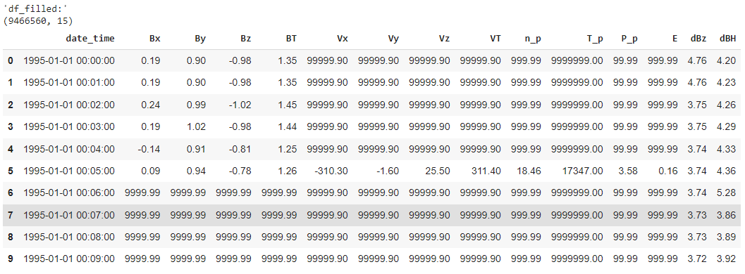
Values exploration | 999999 ?
5

Slide 54
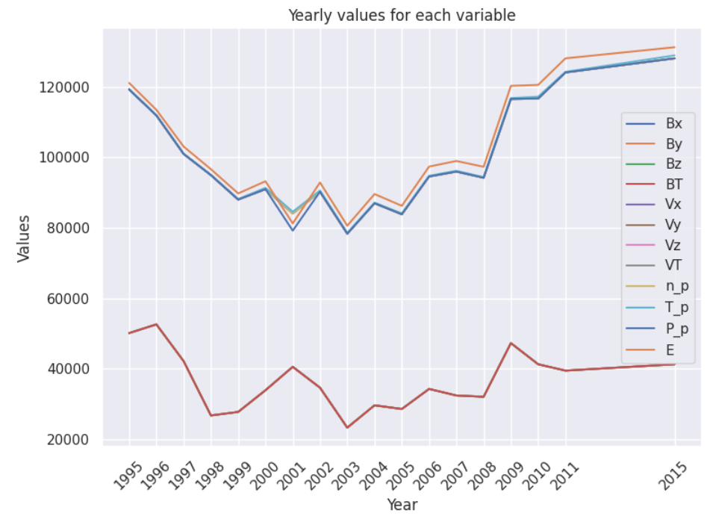
Value exploration
6

Slide 55
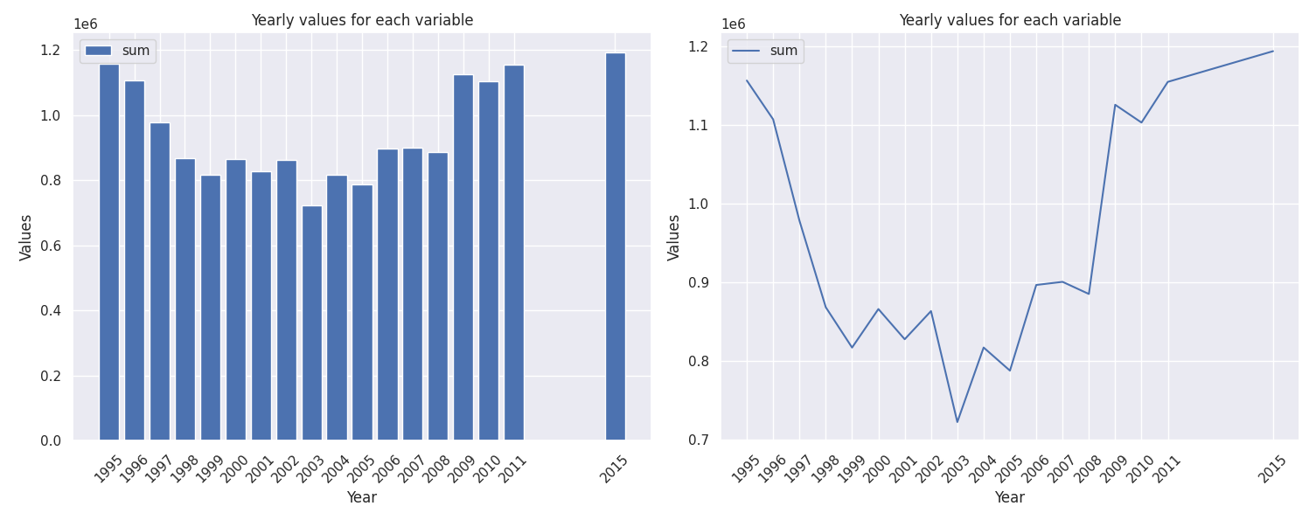
Values exploration | 999999 ?
7

Slide 56
Solution?
8
The datasets should be downloaded again
2. Ignore this and continue
3. This is a big deal, and finding a solution is essential

Slide 57
Weekly Report 10
07/27/2023

Slide 58
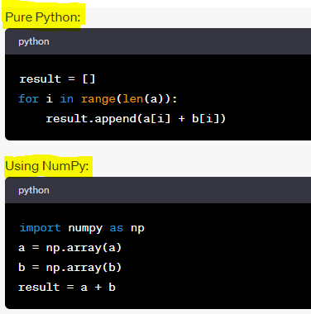
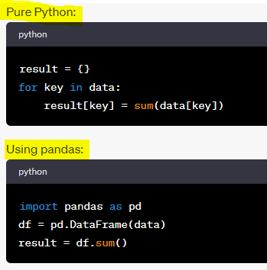
Code optimization | Pure Python to Scientific Python
1
1. Vectorization with NumPy
2. Data Manipulation with Pandas

Slide 59
Code optimization | Pure Python to Scientific Python
2
3. Scientific Computing with SciPy:
SciPy is built on NumPy.
SciPy provides more utilities for:
optimization, linear algebra, integration, interpolation, special functions, FFT, signal and image processing, ODE solvers, and more.
4. Parallel Computing with joblib or Dask:
Speed up processing times.
5. Just-In-Time Compilation with Numba:
Best suited for mathematical functions, like those used in machine learning and data analysis.
6. Efficient Array Computing with JAX:
Powerful transformations.
7. Profiling:
Allows you to focus your optimization efforts on the slowest parts of your code.

Slide 60

Paper
3
The authors:
Focus on ACE satellite data. (1998 -2020)
Used AI techniques such as machine learning and statistical inference to analyze the ACE data and gain insights into the solar wind.
They found that some parameter distributions are well approximated by Gaussian distributions while others are closer to lognormal laws.
Important: Pre-processing
The magnitude of Values
Spread values seem dangerous to implement in a deep-learning algorithm without a pre-process.

Slide 61

The magnitude of variables
4
Feature Scaling:
It fits within a specific scale, like 0-100 or 0-1.
2. Understanding Data:
gaining insights from the statistical properties of the data
3. Outlier Detection:
They might be due to variability in the data.
They may indicate experimental errors.
4. Normalization:
It is a specific type of feature scaling
Normalization typically means rescaling the values into a range of [0,1].

Slide 62
The magnitude of variables
5
5. Improving Accuracy:
Scaling features to a similar range prevents any single feature from dominating the model simply because of its scale.
6. To understand the physical processes involved:
The magnitudes of the variables aren't just numbers - they represent physical quantities tied to real-world processes.

Slide 63
Weekly Report 11
08/03/2023

Slide 64
Important Activities Undertaken During this Week
1
Data Analysis and Code Development
Analyzing Missing Data Patterns: I dedicated time to work on code related to understanding the distribution of missing values across different years in our dataset. This analysis will help us gain valuable insights into potential data gaps and allow us to make informed decisions for data preprocessing.
Literature Review
Researching Previous Works on Missing Data: I spent significant time searching and reading research papers that focus on handling missing data. By studying previous works, I aimed to learn from existing methodologies and best practices to improve our approach in dealing with missing data effectively.
Gap Identification in Space Science Research: While there were numerous papers discussing and comparing missing data handling methods in various fields, including healthcare, finance, and social sciences, I could not find any relevant studies specific to the field of space science. Identifying this gap in the literature is crucial as it presents an opportunity for us to contribute to the domain with our research and potentially adapt and evaluate existing methodologies from other fields to address the challenges unique to space science data.
Hyperparameter Optimization Study
I am studying hyperparameter optimization techniques. I haven't finished it yet. These methods play a crucial role in fine-tuning machine learning models, and by enhancing our understanding of hyperparameter optimization, we can enhance the overall performance of our models.

Slide 65

Analyzing Missing Data Patterns
2

Slide 66

Literature Review | Missing data
3
Singular Spectrum Analysis (SSA) is a method for filling in large gaps in the solar wind and IMF data.
SSA works by reconstructing missing data using an iteratively inferred, smooth "signal" that captures coherent modes, while "noise" is discarded.
SSA can infer smooth temporal modes of co-variability between the solar driver and the response from the existing data.
By combining SSA with geomagnetic indices that are time-continuous, we can fill in large gaps in the solar wind and IMF data.
SSA is a powerful tool for filling in gaps in data, but it is not perfect. The reconstructed data may not be as accurate as the original data, and there may be some errors.
SSA can be used to fill in gaps in a variety of data types, not just solar wind and IMF data.

Slide 67

Literature Review | Missing data
4
This research paper proposes a novel splitting-based IMV-RE (Imputing the Missing Values in Real-Time Environment) algorithm to impute different missing values within a dataset.
How does the IMV-RE algorithm work, and what makes it different from other imputation methods?
The IMV-RE algorithm is a novel splitting-based data imputation algorithm that can predict missing values efficiently and accurately.
The algorithm first decides the upper limit for each feature within a cluster, which is further used for imputing the missing values so that the imputed values lie much nearer to the exact values.
Unlike other imputation techniques, the IMV-RE algorithm only searches within the class to calculate the centered value for the final imputation, which makes it more efficient for real-time problems.
The proposed IMV-RE algorithm successfully abstracts the dependency of the CCMVI technique on the complete samples within a class to estimate the missing values.
The experimentation on ten benchmark datasets indicates that the proposed IMV-RE algorithm outperforms the existing techniques in sensitivity to Accuracy, Root Mean Square Error (RMSE), and Coefficient of Determination (R2).
The IMV-RE algorithm is a robust statistical MVI technique that can handle missing values in a variety of data types.
The algorithm is efficient and can be used for real-time problems.
The IMV-RE algorithm has been shown to outperform other imputation techniques in terms of accuracy, RMSE, and R2.

Slide 68
Weekly Report 12
08/10/2023

Slide 69

Literature Review | Missing data
1
The authors dissect the pros and cons of various methods to handle these missing values, ultimately recommending estimation techniques as the optimal solution for time series data.
Conventional Methods: (Mean and Mode imputation, and deletion)
Advantages:
Simplicity: They are easy to understand and implement.
Generalizability: Can be applied to a variety of datasets, not just time series data.
Effectiveness for Low Missingness: These methods can yield satisfactory results when the percentage of missing data is low.
Disadvantages:
Limited Effectiveness: Their effectiveness wanes when there's a high percentage of missing data.
Bias: They can produce biased results, especially if the missingness is systematic or related to any inherent property of the data.
Loss of Data: Methods like deletion result in a loss of data, leading to reduced efficiency.
Skewed Estimation: The resultant dataset after handling missing values can lead to misleading and biased analyses.
Estimation Methods:
1. Autoregressive-model-based missing values estimation method 5
2. Optimized fuzzy c-means with support vector regression and genetic algorithm 5
3. Fuzzy-rough methods 2
4. Regression analysis 5
5. Support vector regression 5
6. Genetic algorithms 5

Slide 70
Literature Review | Missing data
2
Advantages:
Bias Reduction: They are designed to minimize biases introduced by conventional methods.
Accuracy: Can provide more precise estimates for missing values.
Flexibility: Methods such as genetic algorithms and fuzzy c-means can be tailored according to user needs.
Complementary Use: Can be combined with other methods to enhance accuracy.
Handling Large Missing Data: They are especially suited for datasets with a significant amount of missing values or non-ignorable missing data.
Specialization for Time Series: Many estimation techniques are specifically designed to consider the temporal relationships in time series data.
Disadvantages:
Potential for Bias: While they reduce bias compared to conventional methods, they aren't entirely free from introducing their own biases.
Computational Intensity: Some methods can be computationally intensive, requiring more time and computational resources.
Variable Performance: The effectiveness of a method can vary depending on the specific characteristics of the dataset.
Complex Implementation: Some techniques require a deep understanding of the underlying algorithms, making them challenging for the average user.
Conclusion:
Handling missing values is a critical step in data preprocessing, especially in time series data.
Conventional methods, can be simple but may not be ideal for datasets with a large number of missing values or non-random missingness.
Estimation techniques, offer a more robust and flexible approach to dealing with missing data in such scenarios.

Slide 71

Literature Review | Missing data
3
The authors compare five methods evaluated are:
listwise deletion
mean substitution
regression imputation
stochastic regression imputation
multiple imputations
Conclusion:
Multiple imputation is an effective tool for addressing missing data in logistic regression analyses.
Multiple imputation can be used to handle both MCAR and MAR data types.
Listwise deletion is not biased for MCAR data, but it can be biased for MAR data.
Multiple imputation is generally preferred over listwise deletion for MAR data.
Multiple imputation is especially recommended when dealing with up to 20% missing data.

Slide 72
Code Development | Readability
4
Enhanced Code Readability and Transparency:
Adding informative comments and explanations.
Advantages:
Improved maintenance: Clean and well-documented code is easier to maintain.
Facilitated collaboration: Readable code ensures that colleagues can understand, modify, and work on the code without constantly consulting the original author.
Reduced errors: Clear and transparent code reduces the likelihood of introducing errors.
Increased code longevity: Readable code has a longer lifespan.
Better onboarding: New team members can get up to speed faster if the code is transparent and well-commented.
Reduced dependency: The project becomes less dependent on the original coder.
Professionalism: Well-documented code reflects professionalism.

Slide 73


Code Development | Leap year justification
5
Two types of years:
leap years: 366 days
non-leap years: 365 days

Slide 74

Data problem-solving strategies
6
Misconception:
Machine Learning 80%
Deep Learning 20%
In reality:
Pre-processing 90%
Machine and Deep Learning 10%
My work:
Completed the pre-processing phase, which is the bulk of the work.
My goal: focusing on learning about Machine and Deep learning models. Then commence with the modeling.
Models:
Hyperparameter Optimization
LSTM
CNN
SVM

Slide 75

Hyperparameter Optimization methods

Slide 76

Hyperparameter Optimization methods
1
Concepts
Hyperparameters
Batch size, Epochs, Dropout rate, Learning Rate, Optimizers
Cross join
Optimization methods
1. Gradient-based optimization
2. Grid search
3. Random search
4. Bayesian optimization
5. Adaptive search
6. Early stopping

Slide 77
Parameter vs. Hyperparameters
2
In Machine Learning:
Parameters are estimated from data automatically. (dependent variable)
Examples:
Beta(s) in linear/logistic regression
support vectors in SVM
weights in NN
Hyperparameters are set manually and are used in processes to help estimate model parameters. (independent variable)
Examples:
k in KNN
C and sigma in SVM
learning rate in NN
Do not confuse this nominal similarity:
In Statistics: Like the Gaussian distribution parameters (mean (mu) and standard deviation (sigma)).
In Programming: You may pass a parameter to a function.
Ref: https://machinelearningmastery.com/difference-between-a-parameter-and-a-hyperparameter/

Slide 78

Hyperparameters in neural networks
3
Batch size: The number of training examples utilized in one iteration (The number of batches = The number of times the algorithm's parameters are updated).
Epochs: Indicates the number of passes of the entire training dataset the machine learning algorithm has completed.
Embedding dim: The number of columns of the embedding layer which represents words as numbers.
Hidden size: The number of hidden neurons which it should be between the size of the input layer and the size of the output layer.
Dropout rate: A regularization technique for reducing overfitting in artificial neural networks by turning off a portion of the nodes (In other words not to update a portion of weights).
Learning rate: Determines the step size at each iteration while moving toward a minimum of a loss function.
Optimizer: An algorithm to optimize gradient descent.

Slide 79



Batch size, iterations, epochs
4
Epoch:
The number of practicing the painting.
Pros:
Improve the accuracy = improve the painting
Cons:
- Computational cost = Artist salary
- Overfitting: Learning one kind of tree well but not experienced on the other trees.
Batch size:
The number of English words we can memorize every day.
(words=6, batch size=2, iteration=3)

Slide 80


Cross join
5
3 * 2 = 6
4 * 4 * 4 * 4 * 9 * 4 * 9 = 82,944

Slide 81

Hyperparameter Optimization methods
6
1. Gradient-based optimization
2. Grid search
3. Random search
4. Bayesian optimization
5. Adaptive search
6. Early stopping
Ref:
Hyperparameter optimization https://en.wikipedia.org/wiki/Hyperparameter_optimization
Adaptive Hyperparameter Tuning https://determined.ai/assets/images/resources/AdaptiveHyperparameterTuning.pdf

Slide 82

1. Gradient-based optimization
7
An overview of gradient descent optimization algorithms
2.1 Batch gradient descent
2.2 Stochastic gradient descent
2.3 Mini-batch gradient descent
Mini-batch gradient descent is typically the algorithm of choice when training a neural network and the term SGD usually is employed also when mini-batches are used.
4 Gradient descent optimization algorithms
4.1 Momentum 4.2 Nesterov Accelerated Gradient 4.3 Adagrad 4.4 Adadelta 4.5 RMSprop 4.6 Adam 4.7 AdaMax 4.8 Nadam
Ref: 1. https://arxiv.org/abs/1609.04747
2. https://www.analyticsvidhya.com/blog/2021/06/complete-guide-to-gradient-based-optimizers/

Slide 83

1. Gradient-based optimization
8
2.1 Batch gradient descent
2.2 Stochastic gradient descent
2.3 Mini-batch gradient descent
Mini-batch gradient descent is typically the algorithm of choice when training a neural network and the term SGD usually is employed also when mini-batches are used.
4 Gradient descent optimization algorithms
4.1 Momentum 4.2 Nesterov Accelerated Gradient 4.3 Adagrad 4.4 Adadelta 4.5 RMSprop 4.6 Adam 4.7 AdaMax 4.8 Nadam
Ref: 1. https://arxiv.org/abs/1609.04747
2. https://www.analyticsvidhya.com/blog/2021/06/complete-guide-to-gradient-based-optimizers/

Slide 84


Optimizers | Momentum
9
Ref: https://arxiv.org/abs/1609.04747

Slide 85

2. Grid search
10
Grid search across different values of two hyperparameters. For each hyperparameter, 10 different values are considered, so a total of 100 different combinations are evaluated and compared.
Blue indicates regions with strong results.
Red contours show regions with poor results.
(1, 1) | (1, 2) | (1, 3)
(2, 1) | (2, 2) | (2, 3)
Ref: Hyperparameter optimization https://en.wikipedia.org/wiki/Hyperparameter_optimization

Slide 86

3. Random search
11
Random search across different combinations of values for two hyperparameters. In this example, 100 different random choices are evaluated. The green bars show that more individual values for each hyperparameter are considered compared to a grid search.
Blue indicates regions with strong results.
Red contours show regions with poor results.
(1, 1) | (1.2, 1.8) | (0.8, 3.3)
(2.3, 0.9) | (2.1, 2.2) | (2.5, 3.7)
Ref: Hyperparameter optimization https://en.wikipedia.org/wiki/Hyperparameter_optimization

Slide 87
Random search outperforms Grid search
12
Random search outperforms Grid search because in Random search more individual values for each hyperparameter are considered compared to a grid search.
(1, 1) | (1, 2) | (1, 3)
(2, 1) | (2, 2) | (2, 3)
(1, 1) | (1.2, 1.8) | (0.8, 3.3)
(2.3, 0.9) | (2.1, 2.2) | (2.5, 3.7)
Ref: Hyperparameter optimization https://en.wikipedia.org/wiki/Hyperparameter_optimization

Slide 88

4. Bayesian optimization
13
Methods such as Bayesian optimization smartly explore the space of potential choices of hyperparameters by deciding which combination to explore next based on previous observations.
In practice, Bayesian optimization has been shown to obtain better results in fewer evaluations compared to grid search and random search, due to the ability to reason about the quality of experiments before they are run.
Blue indicates regions with strong results.
Red contours show regions with poor results.
The green bars show that more individual values for each hyperparameter are considered compared to a grid search.
Ref: Hyperparameter optimization https://en.wikipedia.org/wiki/Hyperparameter_optimization

Slide 89


5. Adaptive search
14
Adaptive search is not a general approach.
Main idea: We are not willing to watch a game that one side is winning by a large margin.
Ref: Adaptive Hyperparameter Tuning
1. https://arxiv.org/abs/2107.00275
2. https://determined.ai/assets/images/resources/AdaptiveHyperparameterTuning.pdf

Slide 90

Adaptive search | a simplified example
15
There are seven hyperparameters here:
Step 1. We use the value of the first row for the first six hyperparameters but all values of the seventh hyperparameter (optimizer).
Step 2. The calculations continue with the first row of the first five hyperparameters, the second row of the sixth hyperparameter (learning rate), and all rows of seven hyperparameters (optimizer).
Step 3. We repeat the second step, except that we choose the third row and again the fourth row for the sixth parameter (learning rate).
Step 4. The results show that "Adam" had much better results than other optimizers when calculating all 36 combinations. So we only use Adam as the optimizer for doing other scenarios.

Slide 91


6. Early Stopping
16
A major challenge in NN: Training time
Too little time = underfit
Too much time = overfit
Solution 1:
To stop training as soon as the validation error reaches a minimum.
Solution 2 (for Stochastic and Mini-batch Gradient Descent):
To stop only after the validation error has been above the minimum for some time (when you are confident that the model will not do any better).

Slide 92
Weekly Report 13
08/17/2023

Slide 93

The progress of my project
1

Slide 94



GIC | README
2

Slide 95

GIC | README
3

Slide 96

0. Archive
4

Slide 97



1. Report
5

Slide 98



2. Code
6

Slide 99


3. Data
7

Slide 100



4. Concepts _ Books _ Papers
8

Slide 101
Roadmap on our paper
9
Title: From Solar Wind to SuperMAG: A Comparative Exploration of Missing Data Filling Methods Leveraging Machine and Deep Learning Algorithms
1. Introduction
Background:
The significance of predicting solar storms.
The challenges of dealing with noisy time-series data.
Problem Statement:
Highlight the issue of missing data in solar wind datasets.
The necessity of choosing an appropriate method to handle missing values, as it can significantly influence the quality of predictions.
Objective:
The aim of the paper is to compare different missing data imputation methods
Evaluate their performance using various machine learning models.
2. Related Work
Review previous works related to solar wind data analysis.
Discuss previous methods employed to handle missing data in this or related fields.
Identify gaps in the existing literature (e.g., lack of comprehensive comparison, outdated imputation techniques, etc.)

Slide 102
Roadmap on our paper
10
3. Methods
Dataset Description:
Describe the dataset in detail, highlighting the features and their significance.
Provide statistics on the missing data.
Missing Data Imputation Techniques:
Conventional Methods: (Mean and Mode imputation, and deletion)
Estimation Methods:
Miss Forest
Mice Forest
KNN Imputation
Bayesian imputation
Multiple imputation
Expectation-maximization
Stochastic regression imputation
Machine /Deep Learning Models:
LSTM
CNN
SVM
RF

Slide 103
Roadmap on our paper
11
4. Experiments & Results
Experimental Setup:
Discuss how you split the data (train/test/validation).
Describe any preprocessing steps (aside from the imputation).
Evaluation Metrics:
Explain the metrics you'll use to evaluate the performance (e.g., RMSE, MAE, etc.).
Results:
Tabulate or visualize the results for each combination of the imputation method and machine learning model.
Highlight which imputation method works best for each model.
5. Discussion
Analyze the results in-depth.
Why did some methods perform better than others?
Are there any patterns?
Discuss the real-world implications of your findings, especially in the context of predicting solar storms and mitigating their impacts.

Slide 104
Roadmap on our paper
12
6. Conclusion & Future Work
Summarize your findings.
Propose directions for future research.
Improving the imputation methods
Investigating other machine learning models
Applying the methodology to other datasets.
7. Acknowledgments & References
Thank those who contributed to the paper or provided data/resources.
List all references you cited in the paper.

Slide 105

Heartfelt Thanks
13
Offering me the opportunity to join your research group.
Allowing me to work with a real dataset.
Under your mentorship, I've gained a profound understanding of the core concepts.
Your guidance during our meetings has been instrumental to my progress.
I'm also thankful for the support from the other group members.
I'm keen to collaborate further with your research group in the future.

Slide 106
Archive

Slide 107

Big picture
1

Slide 108

Multi-class/lable
2

Slide 109

N unique | unique | value count
3

Slide 110


Missing streak exploration
4

Slide 111
Heartfelt Thanks
13
1. Offering me the opportunity to join your research group. This was a great honor, and I have enjoyed working with such a talented and dedicated team.
2. Allowing me to work with a real dataset. This was a challenging but rewarding experience, and it has helped me to develop my skills in data analysis and interpretation.
3. Under your mentorship, I've gained a profound understanding of the core concepts. Your guidance has been invaluable, and I have a much deeper understanding of the research topic than I would have without your help.
4. Your guidance during our meetings has been instrumental to my progress. I appreciate your willingness to meet with me regularly and answer my questions. Your feedback has been essential to my development as a researcher.
5. I'm also thankful for the support from the other group members. I have enjoyed working with such a supportive and collaborative team. I have learned a lot from them, and I am grateful for their friendship.
6. I'm keen to collaborate further with your research group in the future. I have enjoyed my time working with you and the rest of the group, and I am excited to continue learning and growing with you.

Slide 112
Roadmap on our paper
12
6. Novel Idea (to make your paper unique)
Hybrid Imputation:
The concept of hybrid imputation is to combine the strengths of two or more imputation methods to create a more robust solution.
1. Sequential Hybrid Imputation:
Start with a model-based approach like Expectation-Maximization (EM) to get an initial estimate.
Following the EM-based imputation, apply a neighborhood-based technique like KNN. The rationale is that EM gives a broad imputation based on the overall data distribution, while KNN refines this by considering the local similarity of data points.
2. Model-assisted Imputation:
Use a basic method, such as mean imputation, to fill the gaps initially.
Train a model (e.g., RF or LSTM) on this 'completed' data.
Predict and replace the initially imputed values with the model's predictions, thus refining the imputed values.
3. Feature-driven Hybrid Imputation:
For features with a temporal trend (like solar wind speed), use methods better suited for time-series data, like Expectation-maximization or Bayesian imputation.
For features without a clear temporal pattern, use methods like KNN or Miss Forest.

Slide 113
Roadmap on our paper
12
Temporal Consistency Check:
Given the time-series nature of the solar wind data, it's vital that imputed values don't introduce anomalies when viewed in a sequence.
1. Post-imputation Temporal Smoothing:
After imputation, apply a temporal smoothing filter (like a moving average) to ensure the time-series doesn't have abrupt jumps due to imputation.
2. Anomaly Detection Post-Imputation:
After imputation, run an anomaly detection algorithm to identify and correct values that seem out of place in the time series context.
Models like LSTM can be trained to recognize the 'usual' patterns in the data and can flag values that seem inconsistent.
Iterative Model-based Imputation:
1. Ensemble Learning for Imputation:
Using ensemble methods, such as Random Forest, for imputation isn't new. However, combining them in an iterative manner with deep learning models could be novel.
For instance, first, impute missing values using Random Forest. Then, train an LSTM on this dataset and predict the missing values again. This iterative approach aims to converge on a more accurate imputation.

Slide 114
Roadmap on our paper
12
2. Feedback Loop for Deep Learning Imputation:
Use a deep learning model, e.g., LSTM, to initially predict missing values.
Re-train the model with the newly completed data and iterate this process. The idea is that with each iteration, the imputation becomes more aligned with the underlying data distribution.
Performance Weighted Imputation:
Considering that different imputation methods might perform better for different features or under varying conditions:
1. Weighted Combination:
After imputing using multiple techniques, instead of selecting one, combine the imputations in a weighted manner based on some performance metric during validation.
For example, if KNN and Bayesian imputation are used, the final imputed value could be a weighted average of both methods, where weights are derived from their performance on a validation set.
Closing Thoughts:
The main philosophy behind these novel ideas is to leverage the strengths of multiple imputation methods and models to address the nuances and challenges inherent in imputing time-series solar wind data. The aim is to ensure that the imputed values don't just "fill the gaps" but also maintain the integrity, temporal consistency, and inherent patterns in the original data.

